Slide 1
WEB Technologies (CS-566)
LECTURE # 6– Adding Image, Audio and Video Files to Web Pages

Slide 2
Outline
Adding images to web pages
Using images as links
Using images as Favicon
Adding video to web pages
Adding audio to web pages

Slide 3
Adding images to web pages

Slide 4
Adding images to web pages
<img> tag is used to add images to web pages
SRC attribute of the <img> tag is used to indicate the source of the image
We can add an image by
<img src="url" alt="alternatetext">
<img src=“abc.jpg” alt=“Computer”>
Image in Another Folder
<img src="/images/abc.jpg" alt="HTML5 Icon" style="width:128px;height:128px;">
Image on Another Server
<img src="https://www.w3schools.com/images/w3schools_green.jpg" alt="W3Schools.com">

Slide 5
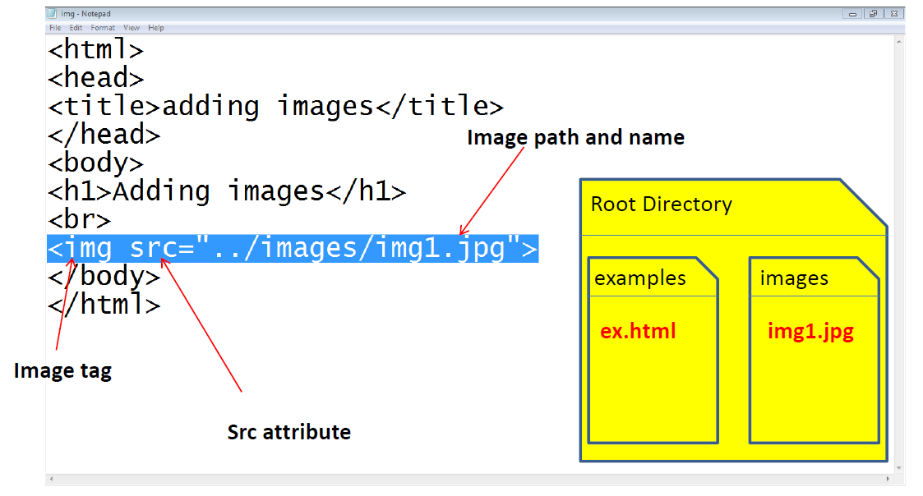
Example

Slide 6
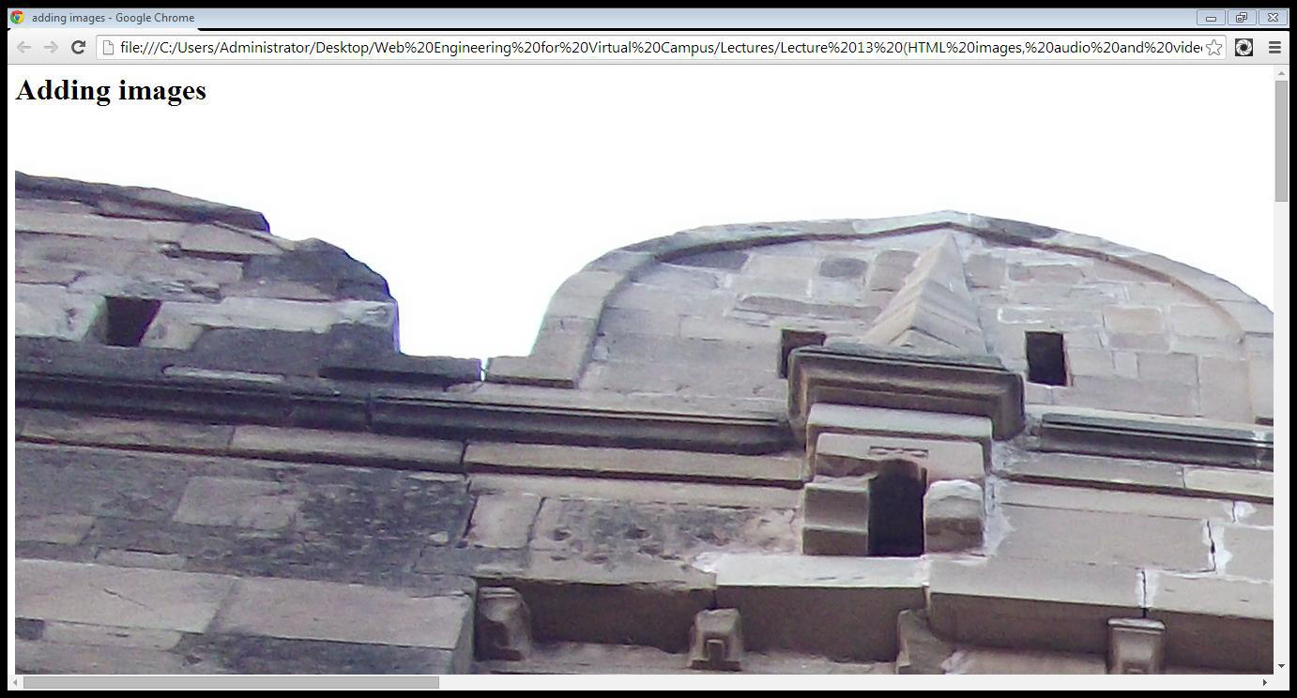
Cont…

Slide 7
Attributes of <img> tag
Height and width:
<img src=“image-name” height=“100” width=“100”>
style="width:128px;height:128px;"
Alt attribute:
<img src=“image-name” alt=“image description”>
Align attribute:
<img src=“image-name” align=“left”>
Left, right, top, bottom, middle
Border attribute:
<img src=“image-name” border=“2”>

Slide 8
Image using for Animation and Float
Animated Image
<img src="programming.gif" alt="Computer Man" style="width:48px;height:48px;">
Floating Image
<p><img src="smiley.gif" alt="Smiley face" style="float:right;width:42px;height:42px;"> The image will float to the right of the text.</p> <p><img src="smiley.gif" alt="Smiley face" style="float:left;width:42px;height:42px;"> The image will float to the left of the text.</p>

Slide 9
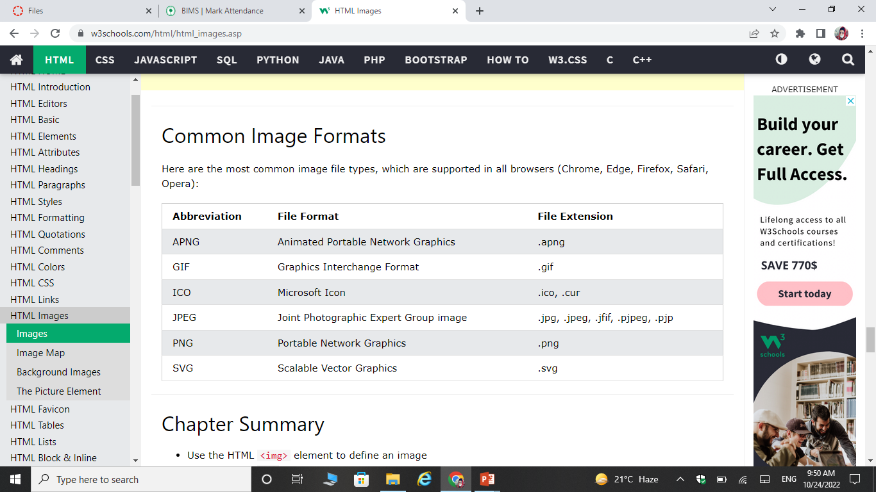
IMAGE Formats

Slide 10
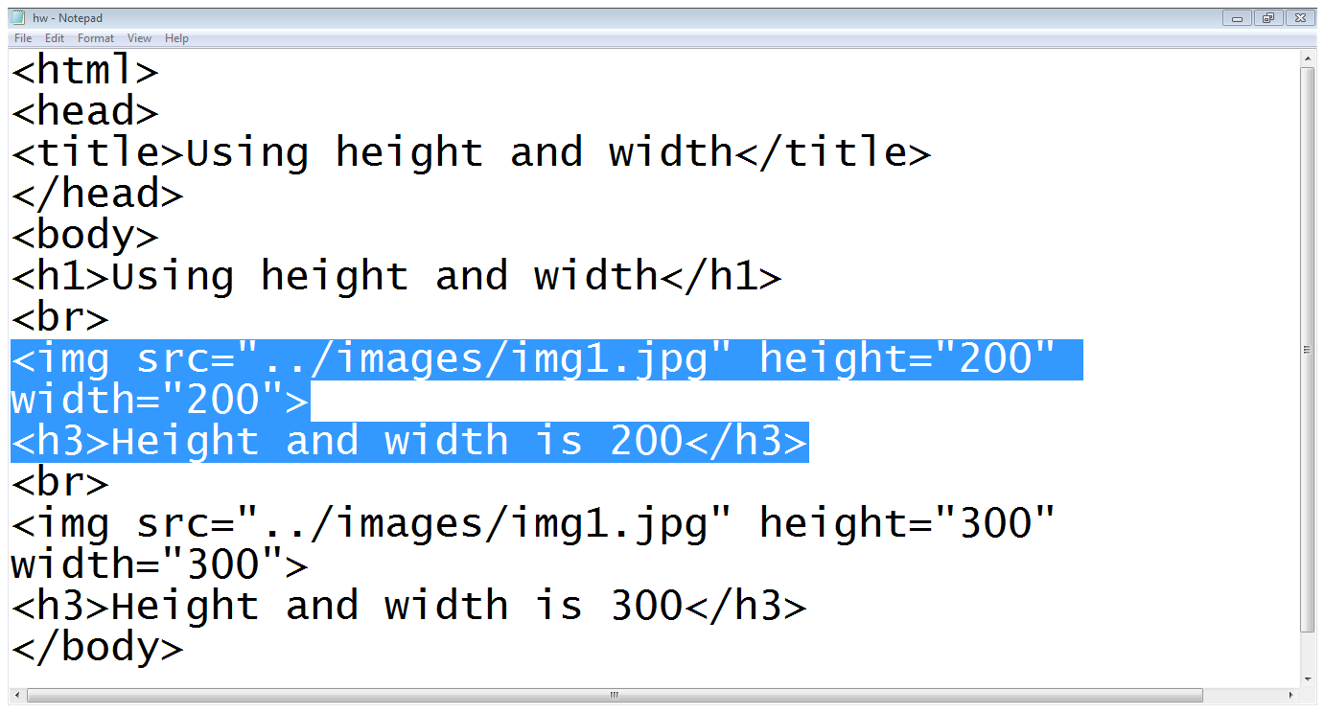
Height and width

Slide 11
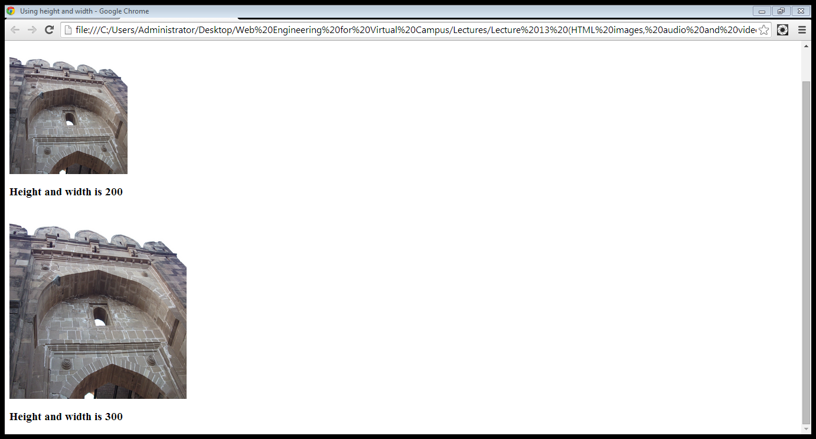
Cont…

Slide 12
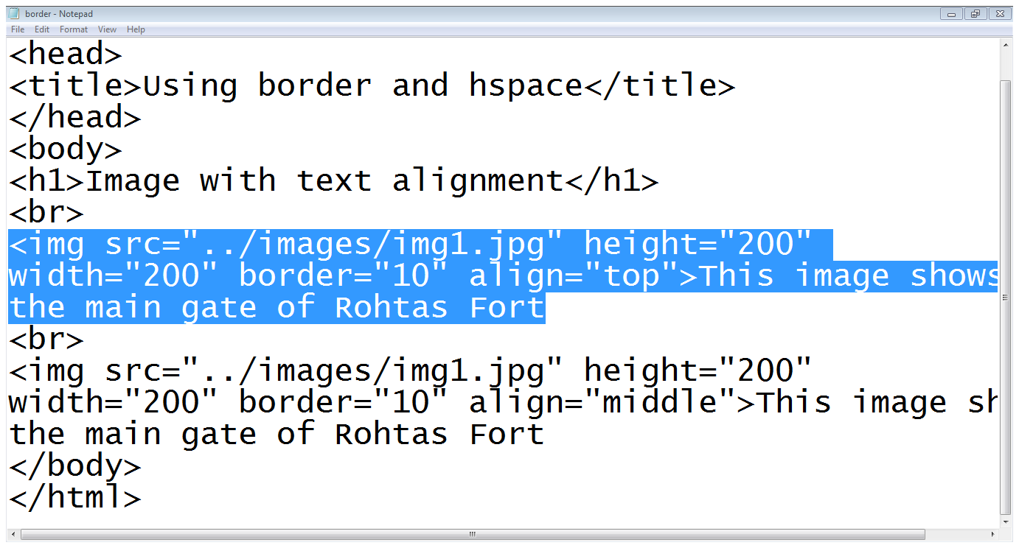
Align and Border

Slide 13
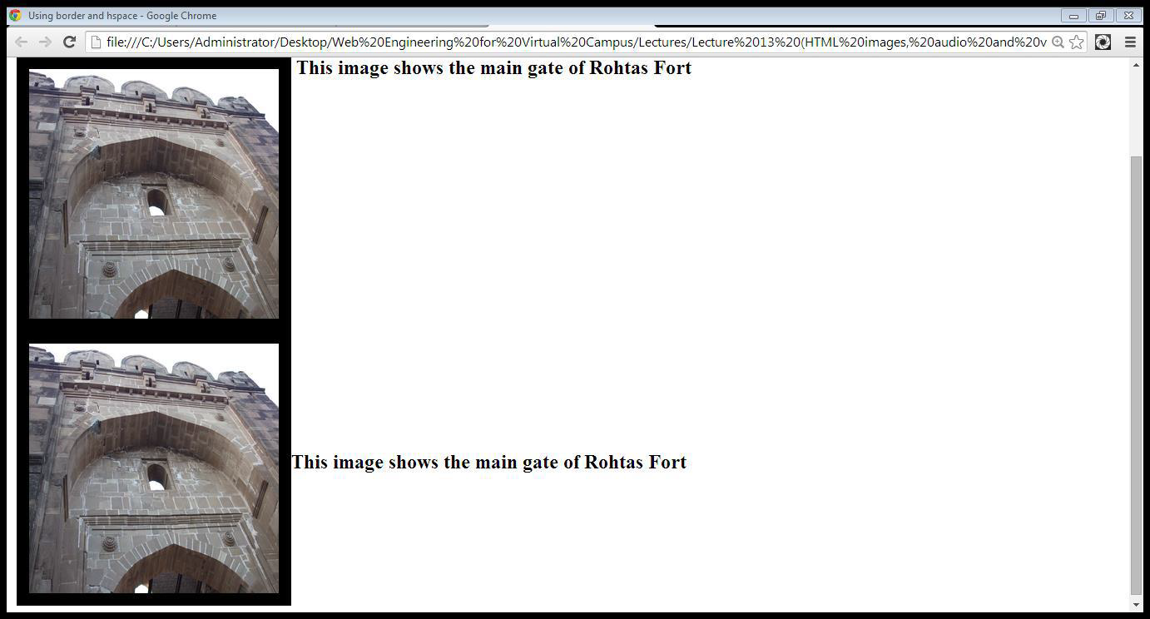
Cont…

Slide 14
Using images for linking

Slide 15
Using images for linking
We can put images between <a> and </a> tags instead of text to link other documents or portions of the page
<a href=“page-reference”> <img src=“image-source”></a>
<a href=“abc.html”> <img src=“img.jpg”></a>
<a href="index2.html"> <img src="img.jpg"></a>

Slide 16
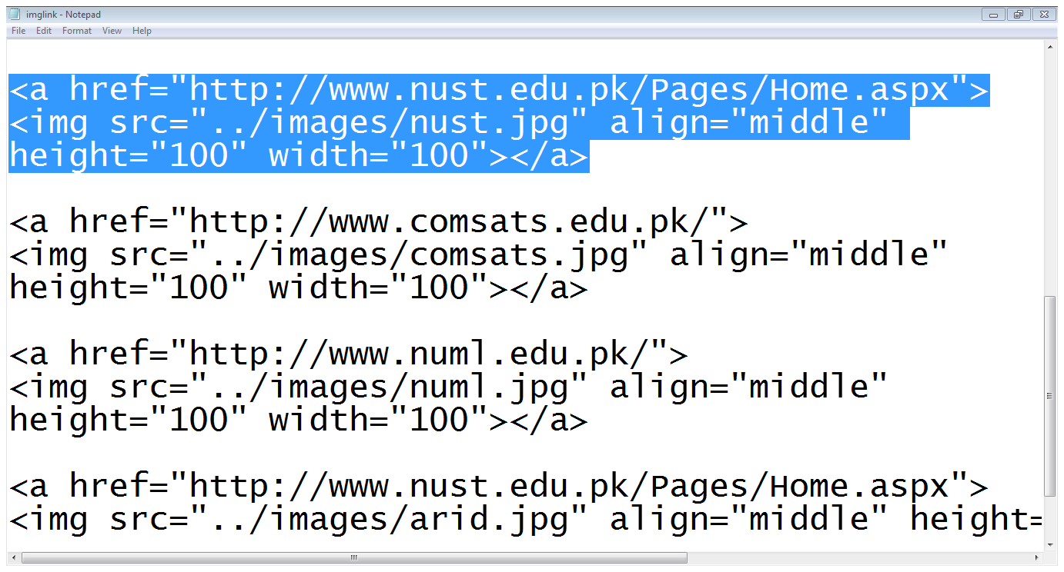
Example

Slide 17
Favicon Image in HTML

Slide 18

Favicon Image in HTML
A favicon image is displayed to the left of the page title in the browser tab, like this:
Tag:
To load Favicon use <link> tag.
Add this tag in <head> tag of html page after <title> tag.
Attributes:
<link rel=“icon” type=“image” href=“favicon.ico”>
You can use any image you like as your favicon. You can also create your own favicon on sites like https://www.favicon.cc.

Slide 19
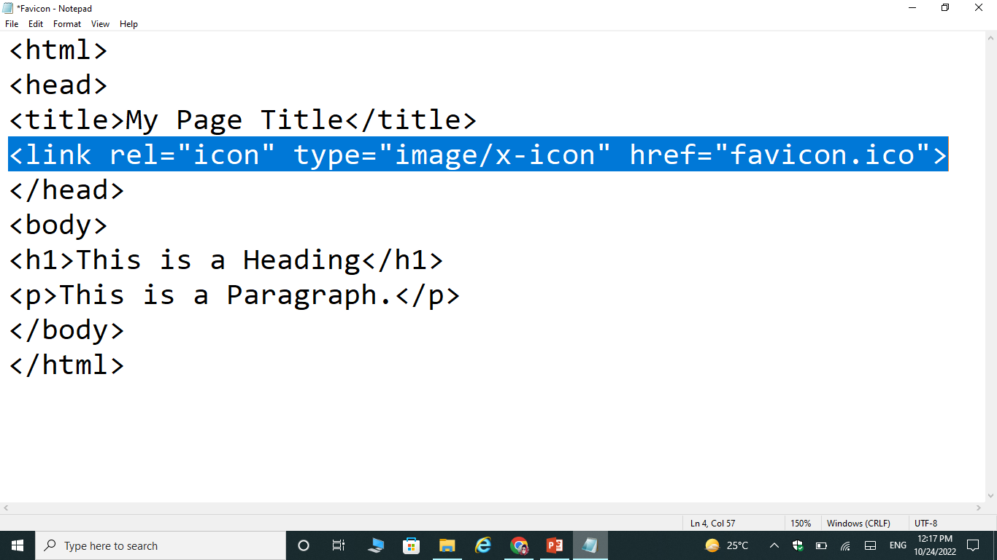
Example

Slide 20
Adding Videos to web pages

Slide 21
Adding videos to web pages
The <video> tag is used to add a video to a web page
This tag is provided in HTML5
The src attribute of the <video> tag is used to indicate the source of the video
We can add a video to our page as
<video src=“abc.mp4”> </video>
OR
<video>
<source src= “abc.mp4”>
<source src=“abc.ogg”>
</video>

Slide 22
Cont…
Attributes of <video> tag:
Auto-play
Controls
Height
Loop
Muted
Type

Slide 23
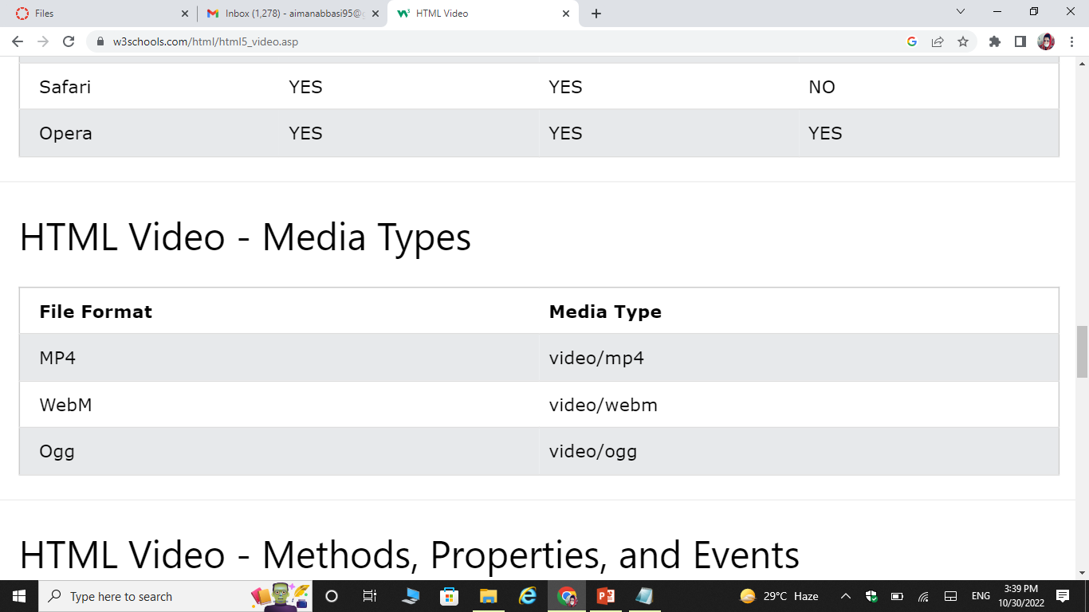
Video Formats

Slide 24
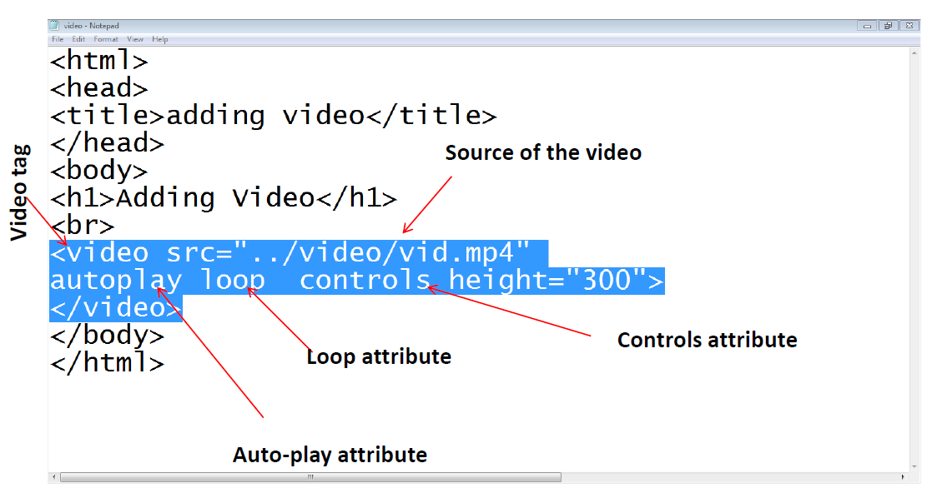
Example

Slide 25
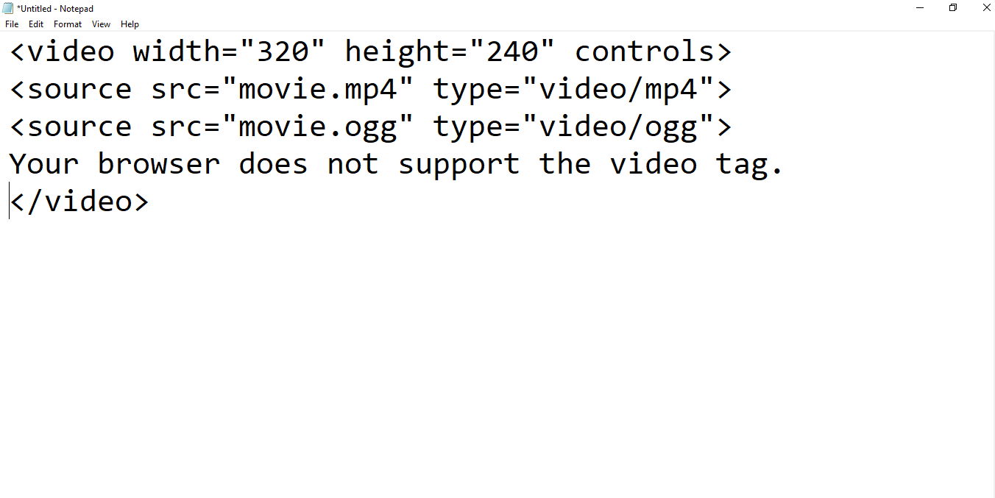
Example

Slide 26
Adding audio to web pages

Slide 27
Adding audio to web pages
The <audio> tag is used to add audio to a web page
This tag is provided in HTML5
The src attribute of the <audio> tag is used to indicate the source of the audio
We can add a audio to our page as
<audio src=“abc.mp3”> </audio>
OR
<audio>
<source src=“abc.mp3”>
<source src=“abc.ogg”>
</audio>

Slide 28
Cont…
Attributes of <audio> tag:
Auto-play
Controls
Loop
Muted
Type

Slide 29
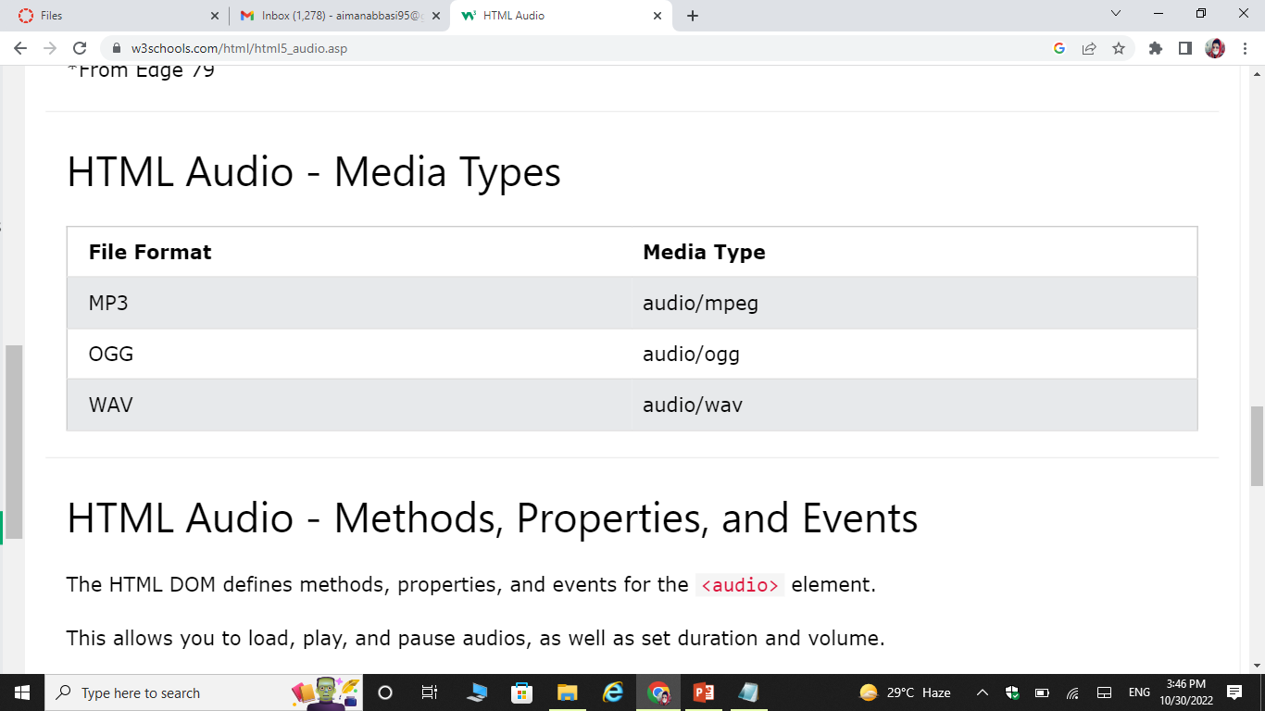
Audio formats

Slide 30
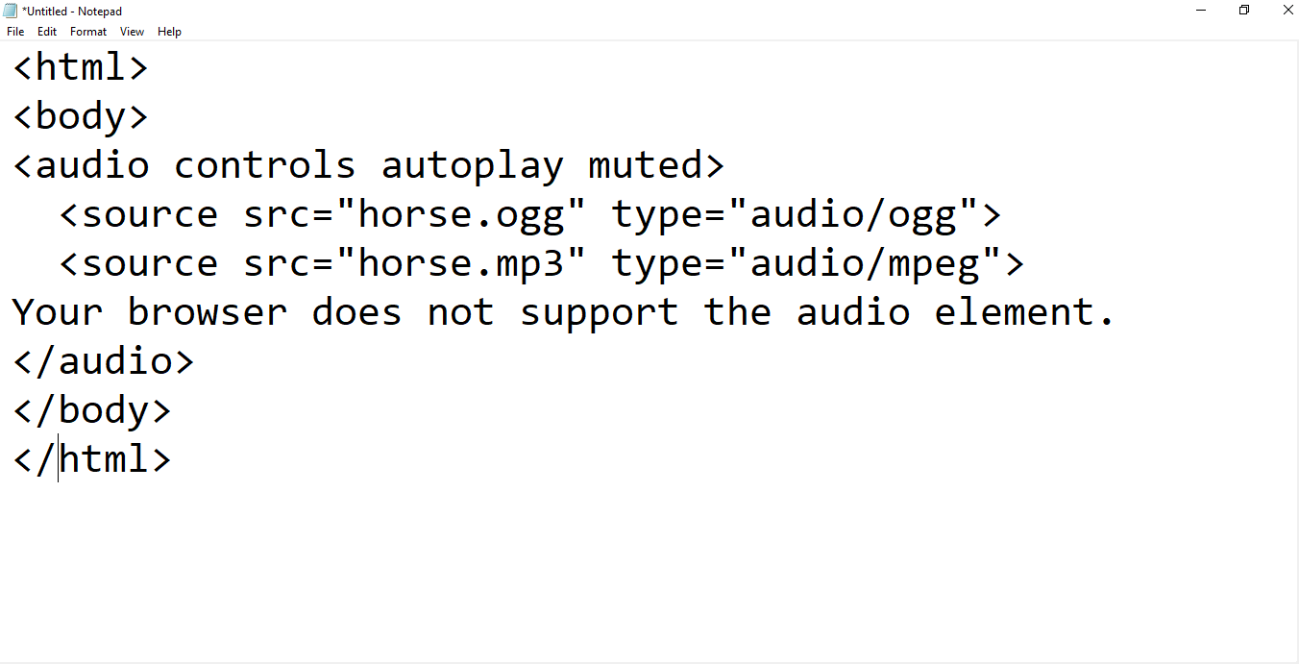
Example

Slide 31
Exercise Questions

Slide 32
Exercise Questions
Add Alt Attribute of <img> tag by using one image.
Practice adding the audio and video to web pages.

